Slide 2
Future2 Slide

Slide 4
Insert generic future slide

Slide 5
Today's Agenda
FPA
Enhance your client experience and strengthen your client relationships with best practice guidance and case studies
Perennial Value Management
Sharing insights on how passive and active management can co-exist in a client’s portfolio
FPA
Get a better understanding of the Financial Adviser Standards and Ethics Authority (FASEA) proposed education standards
Provide input and feedback on the proposed education standards to assist in our consultation process with FASEA

Slide 6
Best interest duty
Notes:
It’s hard to believe five years has passed since the implementation of FoFA. For many of you, the initial implementation of FoFA brought a lot of inefficiency and confusion to your practice. For some, this has improved over the years, and for others, it may still be a struggle as new processes and tools are added. It’s easy to forget the legislation we are trying to solve for. Add to that we are now also seeing case law and a number of ASIC Reports clarifying the operation of FoFA and it can be difficult to know where we are.
The FPA is committed to supporting you to provide high quality financial advice to your clients, in a way that meets your best interest obligations. It is important that all financial planners understand their obligations under the best interest duty. It is also important to understand the best interest duty is more than a compliance checklist.
Acting in the best interest of your client goes beyond a personal belief that you are doing the right thing. It requires documented processes and actions that clearly demonstrate that you have truly acted in the best interest of your client.
This toolkit is based on a practical assessment of the best interest obligations and the FPA Code of Professional Practice. It contains simple and practical tools, guidance and resources, and provides real advice solutions to help you and your business put the best interest theory into practice. Further, it includes case studies that help you demonstrate how the best interest duty works in practice.
We understand you may already have tools and processes embedded within your advice business, either through your licensee or at a practice level. This workbook aims to complement those processes and help you meet your professional obligations as a financial planner.

Slide 7
Best Interest Duty – 2013 to Now
Introduced in July 2013 as part of FOFA
Individual responsibility to act in client’s Best Interest
What is Client’s Best Interest
Reasonably likely to be better off as a result of the advice

Slide 8
Advice obligations
s961B
The best interest duty
s961G
The appropriate advice requirement
s961H
Warn client if advice is based on incomplete or inaccurate information
s961J-L
The obligation to prioritise the client’s interest
Notes:
Booklet is there to help understand these obligations. The booklet helps you understand how the code helps you meet these obligations.
It’s also easy to forget that your advice obligations go beyond just the best interest duty. They also include the appropriate advice requirement, warning clients when advice is based on incomplete or inaccurate information and that you have obligations to prioritise client’s interests over everything else.
One key message to take away from today also is that it is important to identify who is my client. Is it an individual, or a couple, or a trustee, or members.

Slide 9
Best Interest Duty and Safe Harbour
Best Interest Duty
(1) The provider must act in the best interests of the client in relation to the advice.
Safe Harbour
(2) The provider satisfies the duty in subsection (1), if the provider proves that the provider has done each of the following:
(a) identified the objectives, financial situation and needs of the client that were disclosed to the provider by the client through instructions;
(b) identified:
(i) the subject matter of the advice that has been sought by the client (whether explicitly or implicitly); and
(ii) the objectives, financial situation and needs of the client that would reasonably be considered as relevant to advice sought on that subject matter (the client's relevant circumstances );
Notes:
Best interest duty is not a pub test – it is a Corporations Act test – it is an RG 175 test.
There are 2 components to it. 1 says you must at in the best interests of the client in relation to the advice. 2 is there if it isn’t clear you meet 1.
An exercise you should go through each time you provide advice is that:
You should be very clearly able to articulate at the end of the advice why the advice is in the clients best interest.
So lets go through some examples of where things can go wrong.

Slide 10
Best Interest Duty and Safe Harbour
Best Interest Duty
Safe Harbour
(2) (c) where it was reasonably apparent that information relating to the client's relevant circumstances was incomplete or inaccurate, made reasonable inquiries to obtain complete and accurate information;
(d) assessed whether the provider has the expertise required to provide the client advice on the subject matter sought and, if not, declined to provide the advice;
Notes:
Best interest duty is not a pub test – it is a Corporations Act test – it is an RG 175 test.
There are 2 components to it. 1 says you must at in the best interests of the client in relation to the advice. 2 is there if it isn’t clear you meet 1.
An exercise you should go through each time you provide advice is that:
You should be very clearly able to articulate at the end of the advice why the advice is in the clients best interest.
So lets go through some examples of where things can go wrong.

Slide 11
Best Interest Duty and Safe Harbour
Best Interest Duty
Safe Harbour
(e) if, in considering the subject matter of the advice sought, it would be reasonable to consider recommending a financial product:
(i) conducted a reasonable investigation into the financial products that might achieve those of the objectives and meet those of the needs of the client that would reasonably be considered as relevant to advice on that subject matter; and
(ii) assessed the information gathered in the investigation;
(f) based all judgements in advising the client on the client's relevant circumstances;
(g) taken any other step that, at the time the advice is provided, would reasonably be regarded as being in the best interests of the client, given the client's relevant circumstances .
Notes:
Best interest duty is not a pub test – it is a Corporations Act test – it is an RG 175 test.
There are 2 components to it. 1 says you must at in the best interests of the client in relation to the advice. 2 is there if it isn’t clear you meet 1.
An exercise you should go through each time you provide advice is that:
You should be very clearly able to articulate at the end of the advice why the advice is in the clients best interest.
So lets go through some examples of where things can go wrong.

Slide 12
FOS Case Study
BID and Insurance Advice
Review super
Ensure insurances are in place
Goals and Objectives
Rollover super
Purchase Life, TPD and IP Cover
Recommendations
Unable to get insurance without exemptions and significant loading
Existing super had cover
Complaint
Insufficient information collected on health
Existing product research only focused on investment options and balances
Failure to warn client on incomplete or inaccurate information
Large compensation based on loadings and likely hood to claim.
FOS findings
Notes:
This case study comes from FOS, and is Example 2 from the booklet.
Steve the client is getting married shortly and wanted to sort out his financial position. This included reviewing his super, putting insurances in place, but also setting up a savings plan in preparation for buying a home with his soon to be wife. It was agreed given their uncertain financial position post marriage to defer the advice about savings for the home, but super and insurances would be dealt with.
The planner reviewed his current super funds PDS, and based on Steve’s risk profile and investment objectives that his current fund wasn’t appropriate, so he recommended Steve roll over. He also recommended some life, TPD and income protection for Steve.
The super rollover was fine, but when Steve applied for the insurance coverage it was offered with exemptions and significant loadings. On investigation, Steve had appropriate levels of cover in his existing fund without exemptions or loadings. The planner was unable to get the previous super reinstated.
FOS found that Steve’s planner has not collected sufficient health information; existing product investigation had focused on investment options and balanced only; Steve’s planner had failed to warn him that he had relied on incomplete and inaccurate information.
FOS had to calculate compensation based on the increased premiums and likelihood to claim on an exempted term.

Slide 13
BID and Super Switching
Objective
Sort out super
Current has 3 funds with 3 different trustees
ASIC Report 562
Recommendation
s961B(2)(e) – conduct reasonable investigation
Consolidate 3 funds to 1
Benefits of new fund
the ability to switch between options daily;
a more varied menu of options; and
Reports and educational material that are easier to understand.
Must consider the clients existing products and any products the client requests to be considered.
BID Issues
Increased fees
Benefits of fund don’t address clients objective
Notes:
ASIC RG 175 – Example 19
A client has three different superannuation accounts with three different trustees. They approach an advice provider for advice about how best to consolidate their superannuation. The advice provider recommends that the client consolidate all of their superannuation accounts into a new fund, which will have higher ongoing fees than the combined fees of their old superannuation accounts. The new fund would confer certain additional benefits on the client including:
the ability to switch between options daily;
a more varied menu of options; and
reports and educational material that are easier to understand.
There is nothing in the client’s relevant circumstances to indicate that these benefits would be of particular relevance to the client.
ASIC Report 562: Financial advice: Vertically integrated institutions and conflicts of interest:
Highlighted that there is generally a failure where related products are involved to conduct a reasonable investigation
There is also generally a failure to consider the existing products the client has and any products the client may request to be considered.

Slide 14
Takeaways
1. Be aware of BID obligations
2. Review current advice practises
Are you confident your advice process maps to BID
3. If in doubt, refer to the FPA Code of Professional Practice
4. Ask yourself after each piece of advice if:
If the client is likely to be better off as an outcome of the advice
Does the advice really meet the clients goals and objectives
Have the trade-offs and costs been fully offset
Notes:
So – be aware of your BID obligations.
Review your current practices to ensure you are confident your advice process maps to BID
Ask yourself after each piece of advice if:
The client is likely to be better off as an outcome of the advice
Does the advice really meet the clients goals and objectives
Have the tradeoffs and costs been fully offset.
If in doubt, the FPA code of professional practice is used by EDR schemes and courts and provides practical rules to ensure you provide professional advice services.

Slide 15
FASEA Announcements

Slide 16
Financial Adviser Register
Enshrinement of terms Financial Planner/Adviser
Degree + Exam + Professional Year
FASEA
CPD + Code of Ethics
Notes:
The Corporations Amendment (Professional Standards and Education) Bill 2016 was passed in February 2017. It did the following:
Established FASEA to set the new professional and education standards – set up from 1 July 2017.
Made changes to the financial adviser register
Enshrined the term financial planner/adviser which FPA has been asking for since 2012. Now only those registered on the FAR and meeting the new standards can call themselves a financial planner/adviser. From 1 Jan 2019
A new CPD standard for the whole profession from 2019
A code of ethics and code monitoring bodies which everyone will need to sign up for from 2020.
Existing planners will need to meet a new degree equivalence standard by 2024.
All existing planners will need to pass an exam by 31 Dec 2020.
New entrants will need to complete an approved degree, pass the same exam everyone will need to, and complete a professional year where they will be mentored from 1 Jan 2019.

Slide 17
FASEA Ethics – fpa proposed changes

Slide 18
Notes:
While

Slide 19
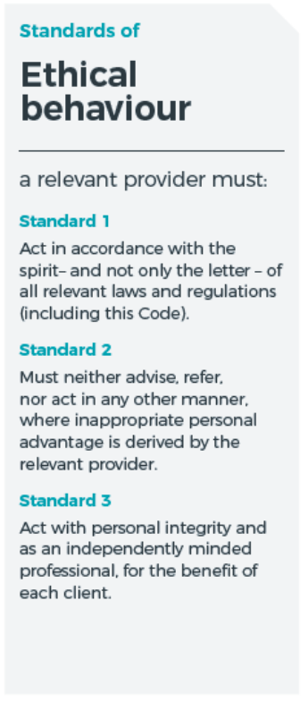
Of this code
Add “in the best interest”
Notes:
FPA’s proposed changes
Standard 1 – Act in accordance with the spirit – and not only the letter – of this Code.
Why?
Spirit? Unified ethos underlying letter of law
Means you can maybe work out what was left unsaid
Almost impossible to find spirit in most laws
By contrast, code of ethics has spirit
Standard 2 – A relevant provider must neither advise, refer, nor act in any other manner, where personal advantage is derived by the relevant provider without the informed consent of the client.
Why?
‘inappropriate personal advantage’ – potentially, too broad
Standard 3 – Act with personal integrity and in the best interests of each client.
Why?
‘independently minded’ – more restrictive that ‘best interests’, with no extra consumer benefit

Slide 20
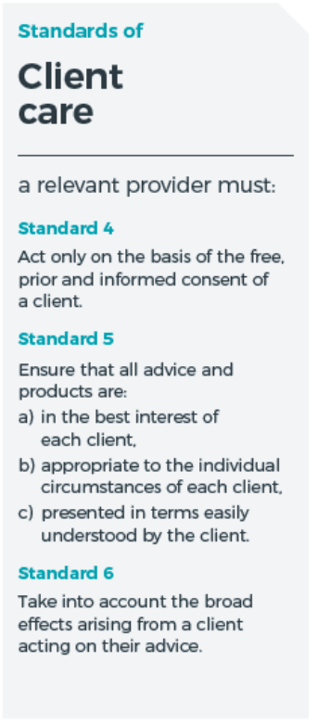
Notes:
FPA’s proposed changes
Standard 4 – Act only on the basis of the prior and informed consent of the client.
Why?
‘free’ – danger if broader than existing law
advisers influence clients
normal influence may be seen as overbearing the will of the client
Standard 5 – Ensure that all advice and products are:
in the best interest of each client,
appropriate to the individual circumstances of each client,
presented in terms understandable by the client.
Why?
‘easily understood’ – some advice and products may not be easy to understand
disservice to clients if this advice and these products are ruled out
Standard 6 – Take into account the broad effects arising from the client acting on the advice.

Slide 21
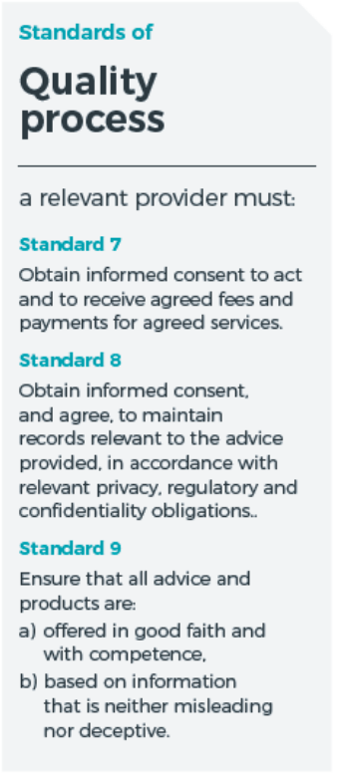
Add “of the client”
Add “the relevant provider believes”
Notes:
FPA’s proposed changes
Standard 7 – Obtain informed consent of the client to receive agreed fees and payments for agreed services.
Why?
‘to act’ already covered by Standard 4
Standard 8 – Obtain informed consent, and agree, to maintain records relevant to the advice provided, in accordance with relevant privacy, regulatory and confidentiality obligations.
Standard 9 – Ensure that all advice and products are:
offered in good faith and with competence,
based on information that the relevant provider reasonably believes is neither misleading nor deceptive
Why?
impractical for adviser to be demonstrably consistent with b) on FASEA’s current wording
‘reasonably believes’ qualification required to make standard practical

Slide 22
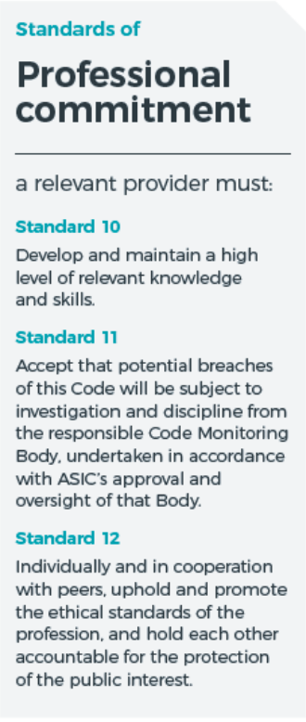
Add “appropriate”
Notes:
FPA’s proposed changes
Standard 10 – Develop and maintain appropriate knowledge and skills.
Why?
‘high level’ – vague standard and, in our view, overreaches
Standard 11 – Accept that potential breaches of this Code will be subject to investigation and discipline from the responsible Code Monitoring Body, undertaken in accordance with ASIC’s approval and oversight of that Body.
Standard 12 – Individually and in cooperation with peers, uphold the ethical standards of the profession, and hold each other accountable for the protection of the public interest.
Why?
‘promote’, in our view, overreaches

Slide 24
FASEA Education

Slide 25
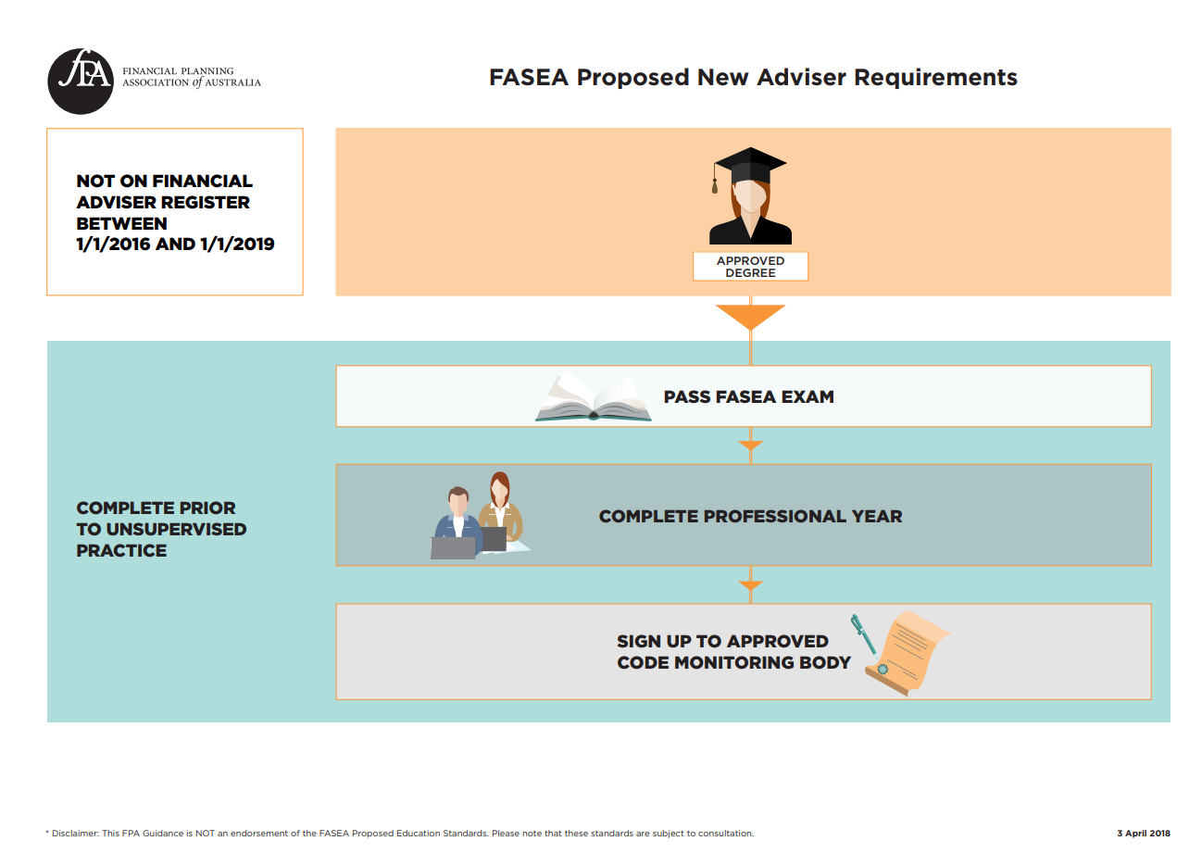
Notes:
Additional option for career changers

Slide 26
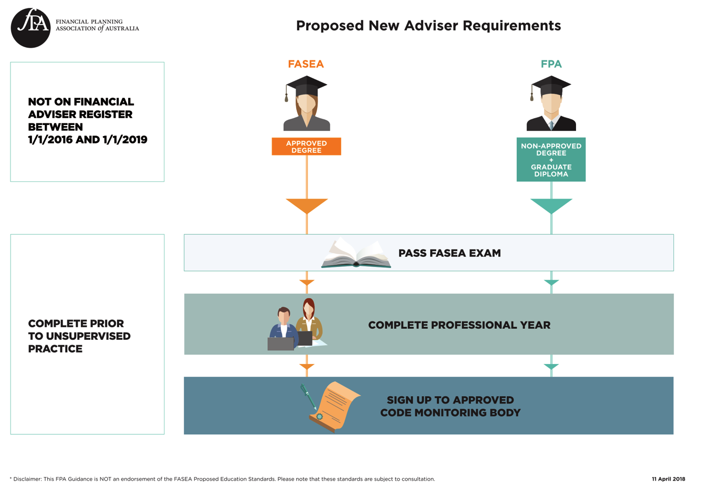
FPA

Slide 27
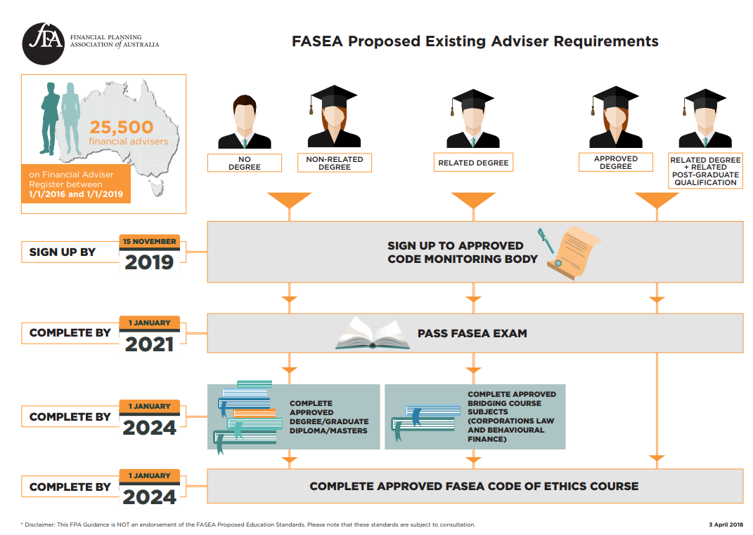

Slide 28
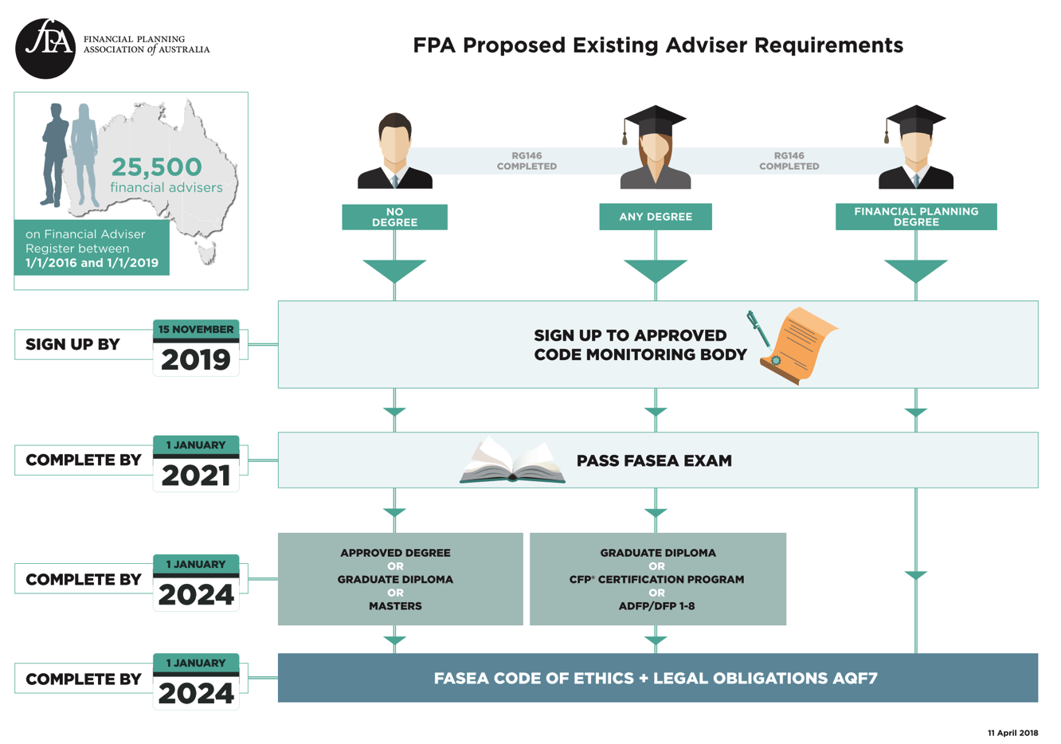
Notes:
In October it was announced that FASEA would adopt FPEC’s Curriculum and Approved degrees list, with an intention to use this as the initial entry standard for new entrants into the financial planning profession. The education standards and transition steps for existing planners, however, are yet be developed. We will continue to work with FASEA on this matter and will keep you informed and supported when this detail becomes available. If you have any questions, please do not hesitate to contact us at policy@fpa.com.au.

