Slide 2
FPA National Roadshow
how passive and active management can co-exist in a client's portfolio

Slide 3
Disclaimer
Issued by: The Investment Manager, Perennial Value Management Limited, ABN 22 090 879 904, AFSL: 247293. Responsible Entity: Perennial Investment Management Limited ABN 13 108 747 637, AFSL: 275101.
Whilst every effort has been made to ensure that the information in this presentation is accurate; its accuracy, reliability or completeness is not guaranteed. Perennial expressly advises that it shall not be liable in any way whatsoever for any loss or damage which may be suffered by any person relying upon such information or any opinion, analysis, recommendation or conclusion contained in this presentation or otherwise arising in connection with the content of, or any omission from, this presentation.
The fact that particular securities may have been mentioned should not be interpreted as a recommendation to either buy, sell or hold those securities.
The contents of this presentation were prepared for information purposes only. Accordingly, reliance should not be placed on this presentation as the basis for making an investment, financial or other decision. This information does not take into account your investment objectives, particular needs or financial situation.
Past performance is not a reliable indicator of future performance. Gross performance does not include any applicable management fees or expenses. Net performance is based on redemption price for the period and assumes that all distributions are reinvested. Fees indicated reflect the maximum applicable.
Contractual arrangements, including any applicable management fee, may be negotiated with certain large investors. Investments in the Trusts must be accompanied by an application form. The current relevant product disclosure statements, reference guides and application forms can be found on Perennial’s website www.perennial.net.au.

Slide 4
Agenda
Why the rapid growth of passive strategies?
What this means for Investors & Advisors?
Active or Passive?
Implications for Active Managers & how they are responding
Unintended consequences

Slide 5
Why the rapid growth in passive strategies?

Slide 6
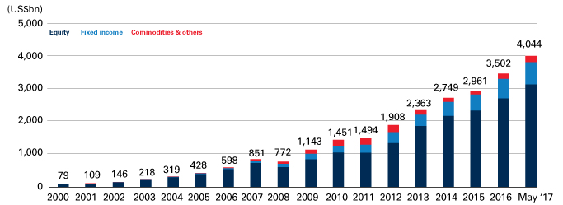
Passive strategies have grown rapidly…
Accelerating growth post-gfc
Figure 1: Global ETF AUM ($USbn)
Source: Blackrock

Slide 7
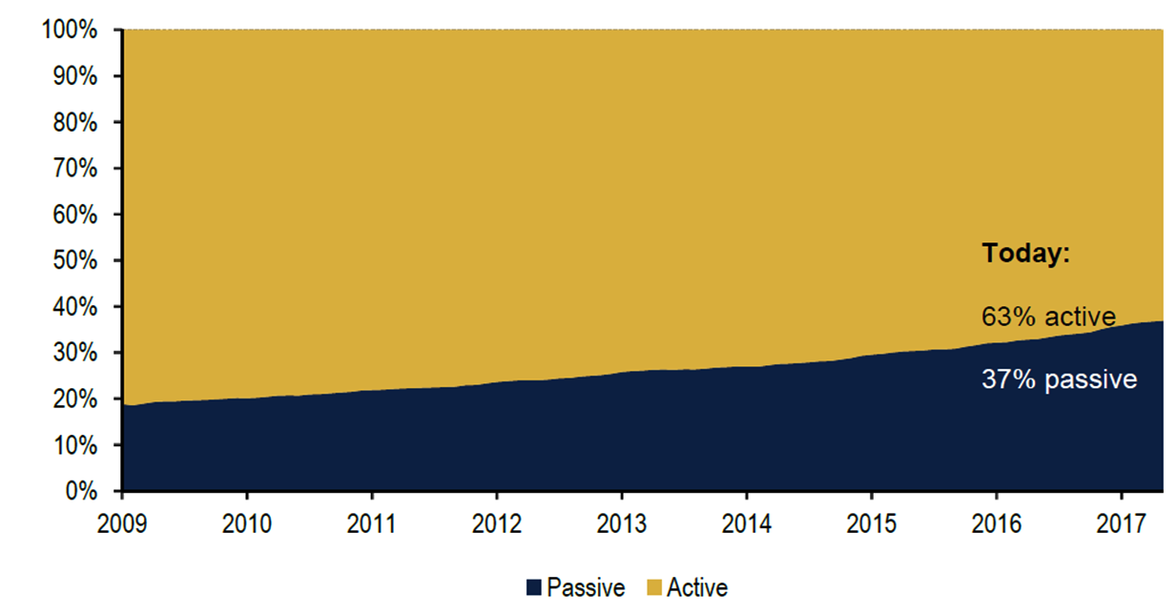
…especially in the US
Us equities market largest passive growth
Chart 3: Asset split between active vs. passive US-domiciled equity funds, 2009-5/2017
Source: Strategic Insight SimFund, BofA Merrill Lynch US Equity & US Quant Strategy

Slide 8
Passive provides a number of benefits...
Catalysts to the growth in passive investing
Low costs – fees matter more in a low-return environment
No benchmark risk – guaranteed to achieve benchmark return (pre-fees)
Wide range of choice – easy access to a large range of asset classes
Listed structure – ETF structures provide convenience and transparency
Less active alpha – active managers have struggled in post-GFC environment

Slide 9
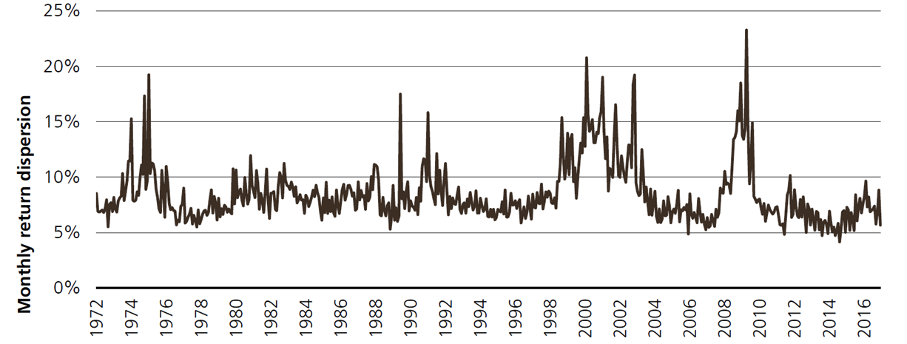
Active alpha prefers high dispersion…
Dispersion has been low post-gfc
Figure 13: Cross sectional volatility of the United States
High dispersion = abundant alpha
Low dispersion = scarce alpha
The difference in returns between individual stocks is low:
=> Picking the right ones doesn’t add as much value
Source: Factset, UBS Quant, Universe: Russell 1000

Slide 10
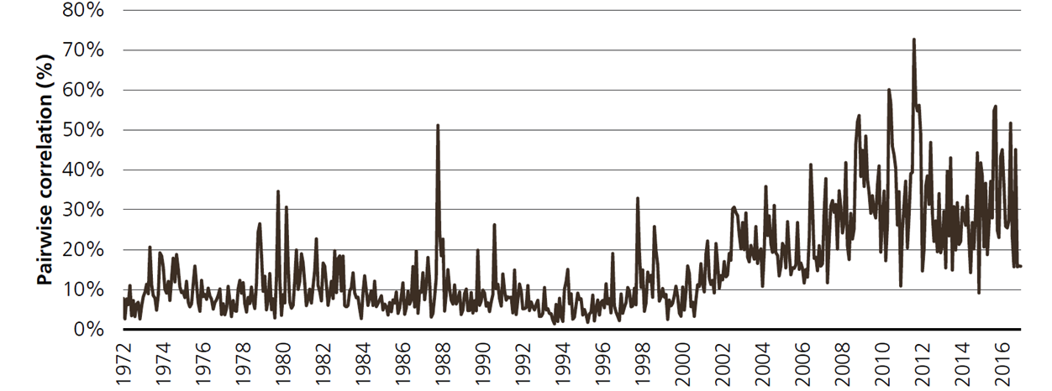
…and low correlation
Correlation has been high post-gfc
Figure 14: Pairwise correlation in the United States
High correlation = clustered macro-driven market
Stocks tend to go up and down together:
=> Hard to add value when everything moves the same way!
Source: Factset, UBS Quant, Universe: Russell 1000

Slide 11
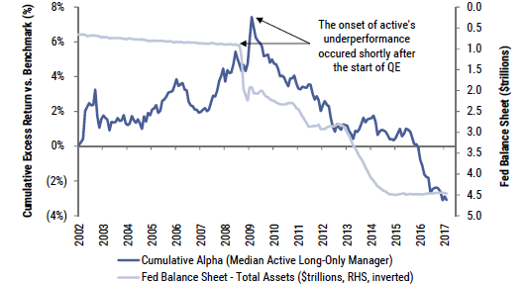
Driven by the effects of QE
The us fed intervention
Did QE trigger the onset of active’s run of underperformance? Managers have consistently lagged their benchmarks since the start of QE
Cumulative Excess Returns for Median Active Manager (LHS) vs. Total Assets on Federal Reserve Balance Sheet ($trillion, RHS, inverted)
Source: Goldman Sachs

Slide 12
What this means for Investors & Advisers?

Slide 13
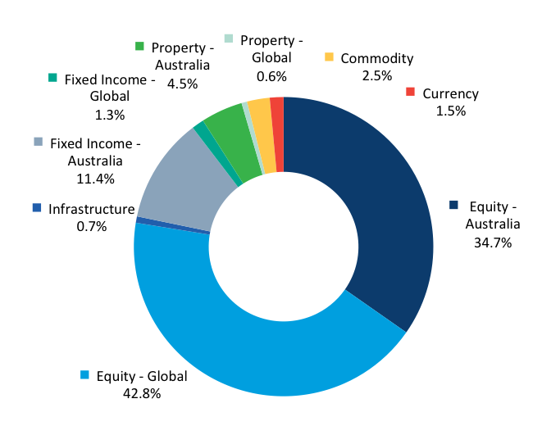
Lots of choice and potential benefits…
Access to a wide range of asset classes
ETP Market Growth
Asset Spread of ETPs, Current Period FUM (A$)
Type to enter a caption.
Source: ASX

Slide 14
…but also comes with some risks
“What should we think about the willingness of investors to turn over their capital to a process in which neither individual holdings nor portfolio construction is the subject of thoughtful analysis and decision making, and in which buying takes place regardless of price?”
– Howard Marks, Oaktree Capital

Slide 15
Adding Value when you need it most
Active managers tend to outperform in down markets
Periods of active outperformance include:
– Recession of the early 1990’s
– Tech-wreck in the early 2000’s
– GFC in 2008-9
Greater allocation to passive = greater sequencing risk

Slide 16
Active or Passive?

Slide 17
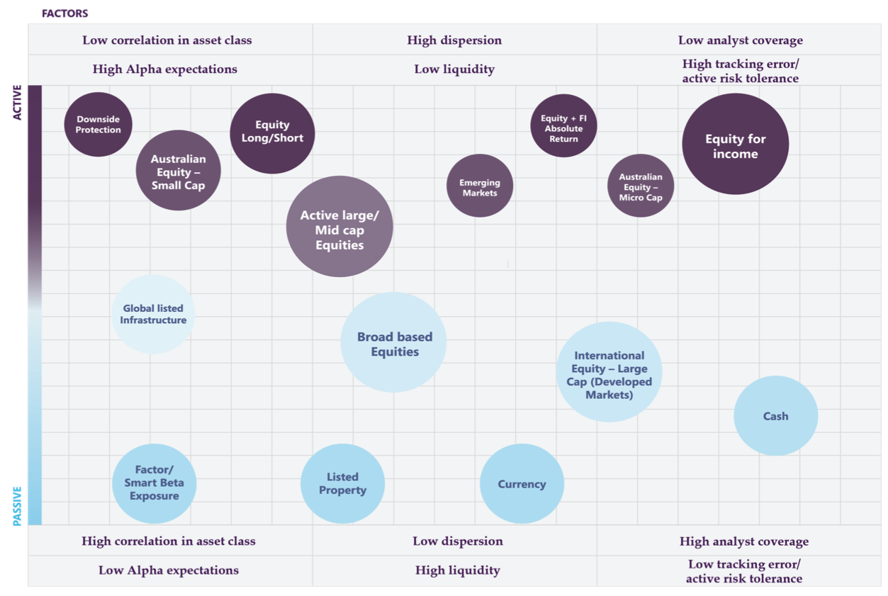
Depends on the strategy
The Active Vs Passive Management framework

Slide 18
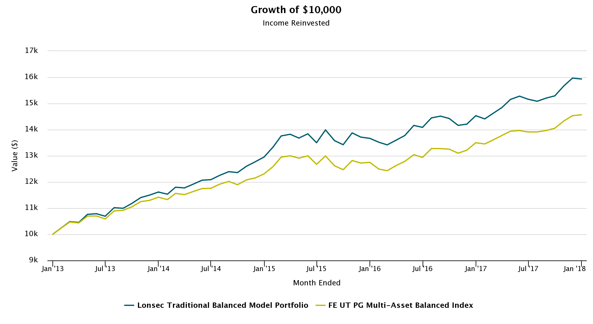
It’s all about Portfolio Construction…
The results can be vastly different
Growth of $10,000 – Income Reinvested
Source: Lonsec

Slide 19
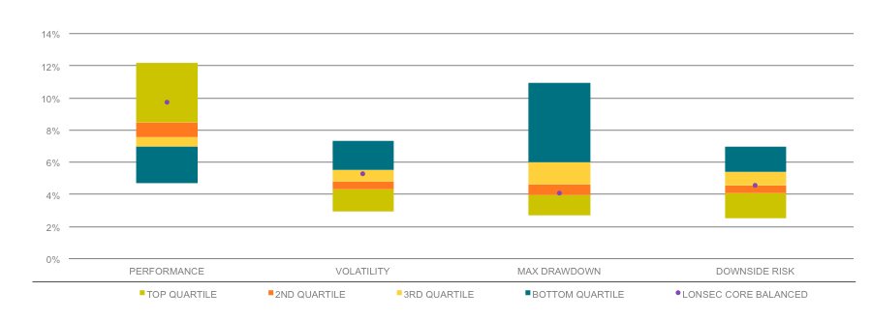
Ask the experts…
Top quartile performance, with lower volatility
Peer Group Comparison^ - 5yr to December 2017
^Comparison against FE UT PG Multi-asset Balanced Index – Source: Lonsec Research, FE Data

Slide 20
Implications for Active Managers & how are they responding?

Slide 21
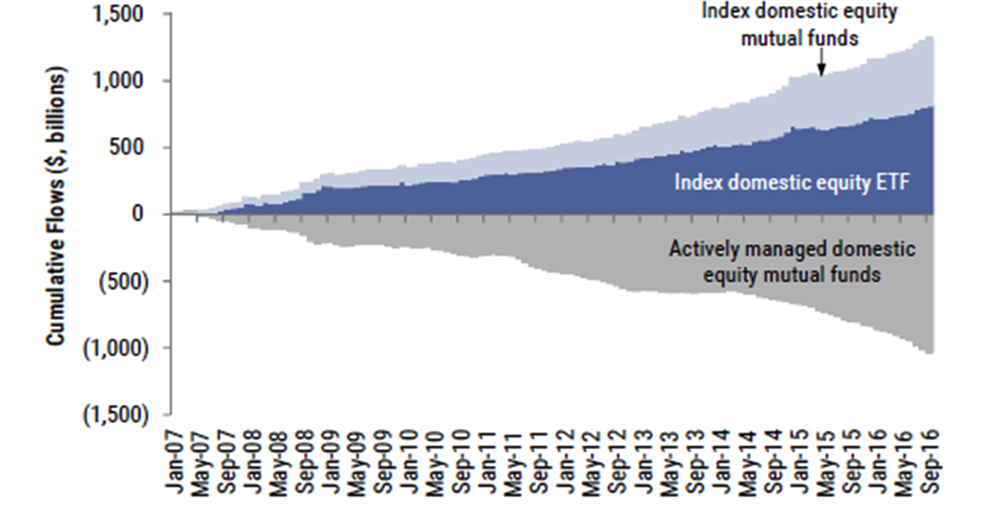
Passive growth at the expense of active
Ongoing net outflows from active
Cumulative flows to and net share issuance of domestic equity mutual funds and index ETFs ($, billions)
Source: Investment Company Institute. Goldman Sachs Global Investment Research.

Slide 22
Responses of active managers
Offering more for less
Product innovation – developing new products not easily replicable by passive strategies
Less benchmark driven – increased focus on absolute returns
Listed structures – moving to listed ETMF structures provide convenience and transparency
Lowering costs – fee structures becoming more competitive
Industry consolidation – driven by institutional in-housing

Slide 23
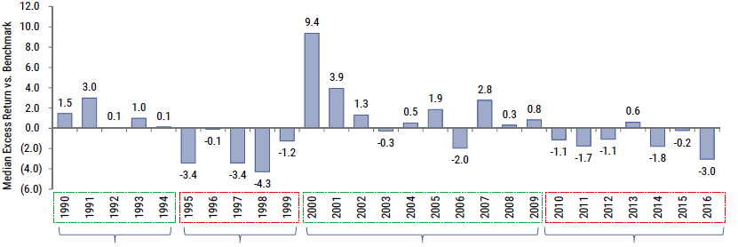
But don’t write active off yet
Active alpha is cyclical
There have been 4 distinct alpha cycles since 1990
Median Excess Returns vs. Benchmark; Includes Actively Managed, Large Cap, Long-Only, US Funds
5 consecutive years of
positive excess returns
5 consecutive years of
underperformance
From 2000 – 2009 the median active manager outperformed in 8 out of 10 years
The median active manager has underperformed in 6 of the last 7 years
Source: Goldman Sachs

Slide 24
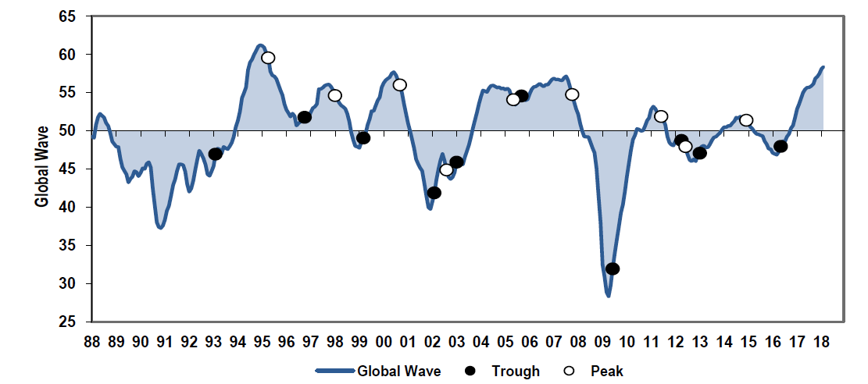
Economic growth is improving
Synchronised global growth
Chart 1: Global Wave
Source: BofA Merrill Lynch Lynch Global Quantitative Strategy, MSCI, IBES, Bloomberg, OECD, IMF

Slide 25
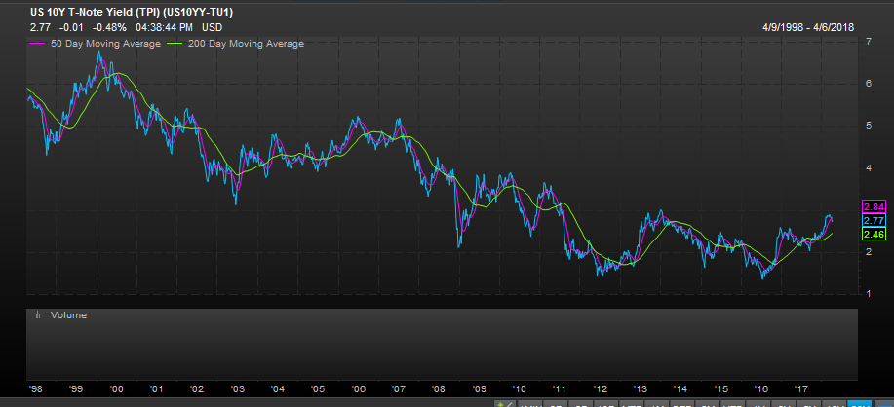
QE is becoming “QT”
Global rate cycle has turned
Source: Factset

Slide 26
Unintended consequences

Slide 27
Passive is now a major force in markets
Passive Investing & Concentration
Chart 1: % S&P 500 market cap owned by Vanguard
Chart 2: % Stocks where Vanguard owns > 5% of float
Source: Chart 1 & 2 – BofA Merrill Lynch US Equity & US Quant Strategy, FactSet Ownership

Slide 28
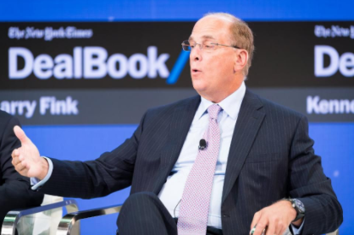
Market efficiency impacts
Passive and activism
“If you're an active manager, and you don't like the company, you can sell the company…I can’t sell.”

Slide 29
Conclusion

Slide 30
Active and passive both have a role to play
Catalysts to the growth in passive investing
Combining Active and Passive makes sense
Global macro policy has driven part of the growth in Passive
Longer-term cycles have favoured both Active and Passive
No one size fits all – it’s all about Portfolio Construction
The changing macro environment could favour Active going forward
There are some unintended consequences to the fast growth in Passive

